Slide 1


Champion Cheatsheets
Division B/C
Georgia Tech Event Workshop Series 2024-25

Slide 2

01
CHEATSHEET RULES
02
GENERAL TIPS
03
CHEATSHEET CONTENT
04
EXAMPLES
05
TIPS FROM A VETERAN
Notes:
For Builds: Replace difficult topics with physical principles involved in the build and replace common questions with common designs

Slide 3
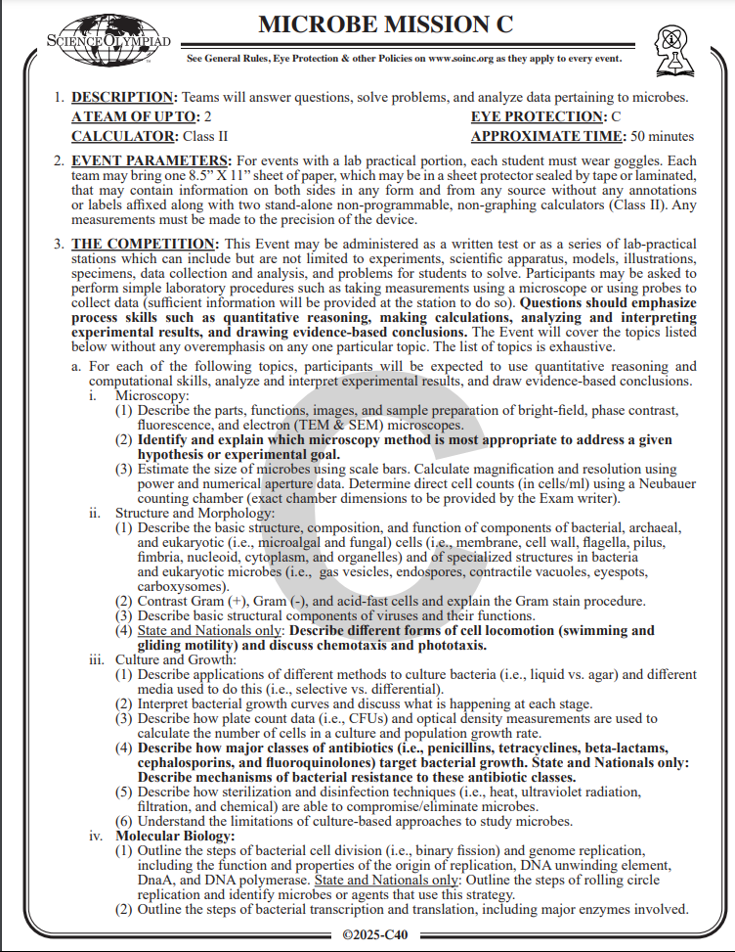
Cheatsheet Rules
Check your event rules sheet for cheatsheet rules under “Event Parameters”!
Typical Cheatsheet Rules:
8.5” x 11” (Letter size)
Usually 1 sheet per team
Front & Back
Cannot affix additional labels to the cheatsheet to increase surface area
May be laminated / sealed in protector
Notes:
Highlight key points from the rules sheet: DESIGN LOGS that basically grant free points, most tested-on topics, point distribution so that competitors know what to prioritize, allowed notes and equipment, etc.

Slide 4
Binder Rules
Check your event rules sheet for binder rules under “Event Parameters”!
Binders may be one per team or one per participant
Some events have binder size limits of 2”, some events have no limit
Some events do not let you remove pages from binder during the event
Material should be secured onto the binder using sheet protectors or through hole-punch
Sheet protectors, laminations, tabs, and labels are typically allowed
Notes:
Highlight key points from the rules sheet: DESIGN LOGS that basically grant free points, most tested-on topics, point distribution so that competitors know what to prioritize, allowed notes and equipment, etc.

Slide 5


General
Tips
Notes:
This section should focus on topics that are more math-based (harder to self-teach), concepts that come only usually up in college level courses, or concepts that you struggled with when you competed in this event

Slide 6
General Tips - Formating Cheatsheets
Include as much information as possible, but keep it readable
Decrease font size, decrease margins
Utilize highlighting and bolding
Eliminate articles (the, a, etc.)
Abbreviate common words (ex: because → bc)
Abbreviate content words if you know them (ex: hydrochloric acid → HCl)
For events with labeling (ex: A&P), include diagrams
May be helpful to draw your own diagrams! Decreasing size of diagrams make words hard to read due to lower image resolution
Print in color, if available

Slide 7
General Tips - Formating Cheatsheets
Organize content by topic
Try to group similar information together or sequentially so that it is easier to find during your event
Don’t write every single piece of information – you will run out of space
Exclude simple content that you can easily study
Know what kind of information you need
Graphs, images, vocabulary, labeled diagrams, equations/formulas
Hand-write / label additional information into margins after printing
Print multiple copies just in case!
Bringing sheet protector can help prevent soggy/wrinkled cheatsheets

Slide 8
General Tips - Google Docs
Google docs is commonly used to create cheatsheets (easy to collaborate!)
Other: microsoft word, canva, OneNote, etc.
Google Docs - Changing Formatting
Adjusting Margins: files → page setup → margins
Adjusting Orientation: files → page setup → orientation
Making Columns: format → columns
Adjusting Image Margins: select image → wrap text → adjust margins
Play around to figure out what works best for your team

Slide 9
General Tips - Formating Binders
Binders are much larger than a single cheatsheet
You can include much more detailed, thorough information
Organization is crucial
Create a table of contents for your binder, use page numbers
Use tabs to easily find sections
Highlight main points, definitions
Compile your resources in google drive and print ahead of time
Hole-punching and organizing takes time

Slide 10


Cheatsheet Content
Notes:
\

Slide 11
Content
Event topics can be found on your Event Rules sheet under
“The Competition"
Read the topics that are included in your level of tournament
There may be more topics included in a state competition than regional
Check for additional resources you can bring
Field guides, national lists
Notes:
Pull some questions from exams on the scioly wiki test exchange, first give attendees a couple minutes to read over them/work through them, then walk them through the answers. Try to get a mix of multiple choice and short answer or matching

Slide 12
Content
For both binder and cheatsheet events, it is best if you have a general understanding of content
Your resource should serve as a supplemental
Read your topics to see what type of information would be useful in your resource, for example:
A&P - labeled diagrams
Fossils - lists, pictures, details, dichotomous key
Chemistry - formulas, rules
Notes:
Pull some questions from exams on the scioly wiki test exchange, first give attendees a couple minutes to read over them/work through them, then walk them through the answers. Try to get a mix of multiple choice and short answer or matching

Slide 13
Content
Where to gather content?
Studying general content knowledge: Khan academy, youtube, simple google searches
Detailed content: textbooks, manuals, nationally published resources
Ask your coach and teammates
There may be resources previous students at your school may have used
Science Olympiad website: event-specific links to resources, practice exams
Notes:
Pull some questions from exams on the scioly wiki test exchange, first give attendees a couple minutes to read over them/work through them, then walk them through the answers. Try to get a mix of multiple choice and short answer or matching

Slide 14
Examples
Notes:
\

Slide 15
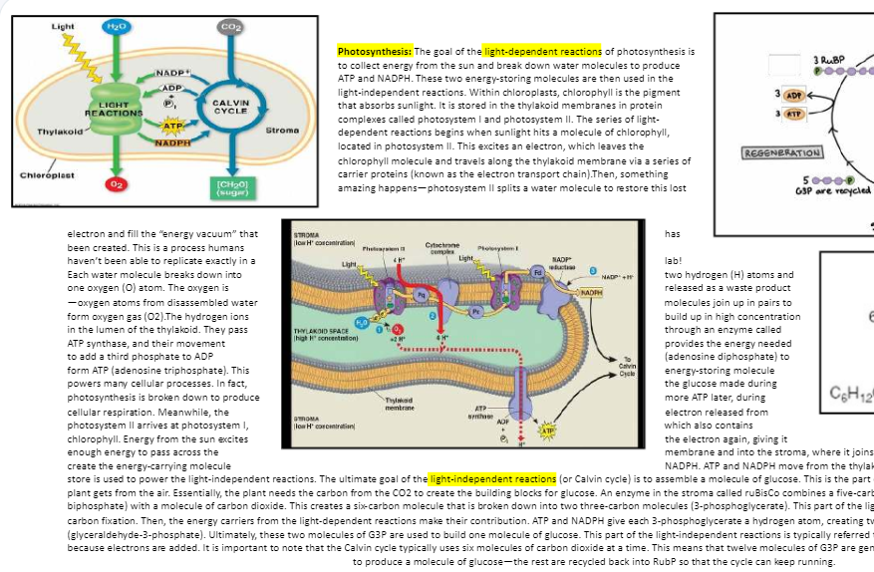
Examples
Great use of diagrams
highlighting, bolding
Word organization could be improved, better sectioned for easier reading
Notes:
Use this section to talk about any strategies you used to navigate the event when you competed. For example, how did you manage your time, how did you organize your notes, how did you split topics up between you and your partner, etc.?

Slide 16
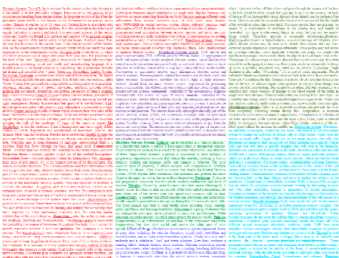
Examples
(I apologize for image resolution)
Color coding topics like this can be an easy way to locate information. Writing in columns can be easier to read.
Notes:
Use this section to talk about any strategies you used to navigate the event when you competed. For example, how did you manage your time, how did you organize your notes, how did you split topics up between you and your partner, etc.?

Slide 17
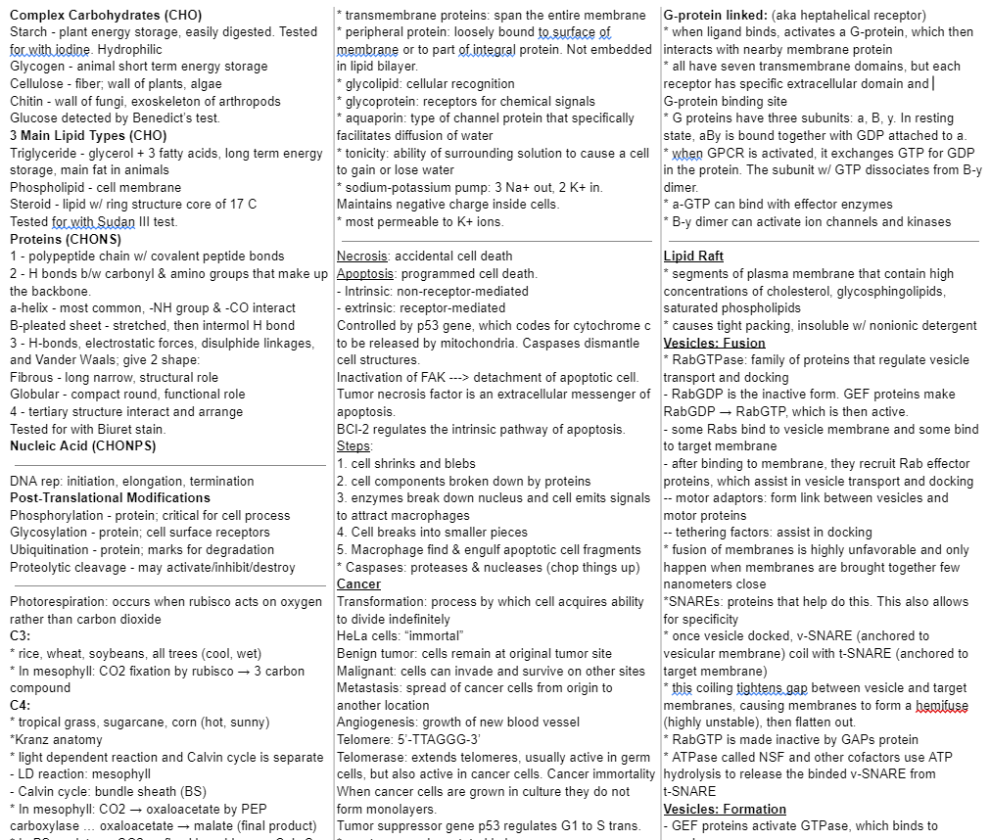
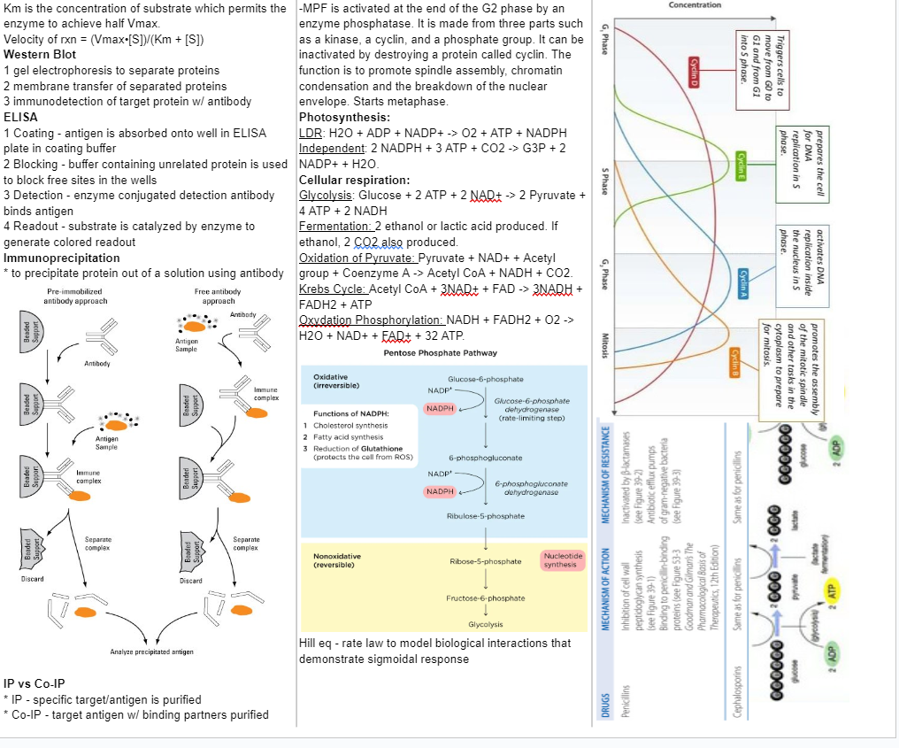
Examples (My Personal Cheatsheet!)
Notes:
Use this section to talk about any strategies you used to navigate the event when you competed. For example, how did you manage your time, how did you organize your notes, how did you split topics up between you and your partner, etc.?

Slide 18
Examples
Ultimately, these are just examples and tips on how you can structure your cheatsheet or binder.
Work with your partner, your team, and coach to build your resource that works best for you.
Notes:
Use this section to talk about any strategies you used to navigate the event when you competed. For example, how did you manage your time, how did you organize your notes, how did you split topics up between you and your partner, etc.?

Slide 19
Tips from a Veteran
Notes:
This section should focus on topics that are more math-based (harder to self-teach), concepts that come only usually up in college level courses, or concepts that you struggled with when you competed in this event

Slide 20
Tips from a Veteran
Split up event topics with your partner
Focusing more deeply on smaller number of topics can be helpful
Try to study and understand the general information within a topic, putting more complex, detailed, difficult to memorize parts of information on the cheatsheet
Know your cheatsheet!
It is inefficient to continuously search for where you wrote information
Notes:
Use this section to talk about any strategies you used to navigate the event when you competed. For example, how did you manage your time, how did you organize your notes, how did you split topics up between you and your partner, etc.?

Slide 21
Tips from a Veteran
Check your printed cheatsheet
Make sure things did not get cut off (personal experience 🥲) and images are visible
Things may look fine on computer and get distorted when printing
Collaborate and work together with your team and coach
Learn and have fun!
Notes:
Use this section to talk about any strategies you used to navigate the event when you competed. For example, how did you manage your time, how did you organize your notes, how did you split topics up between you and your partner, etc.?

Slide 22
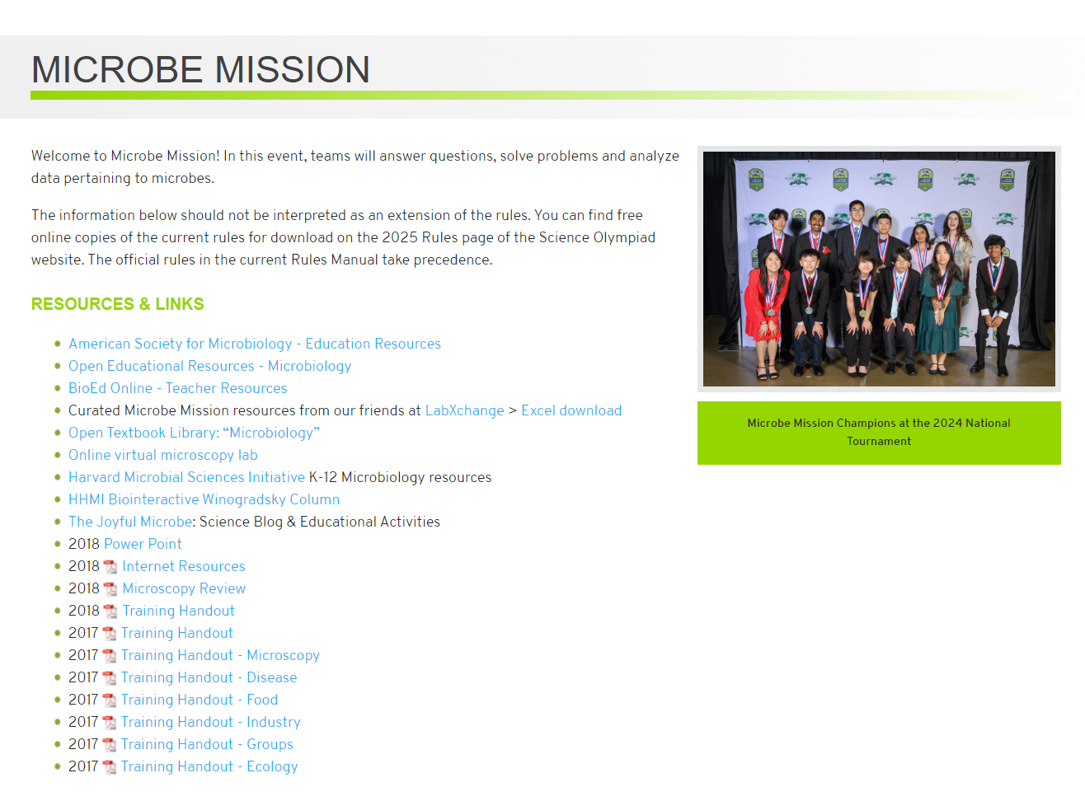
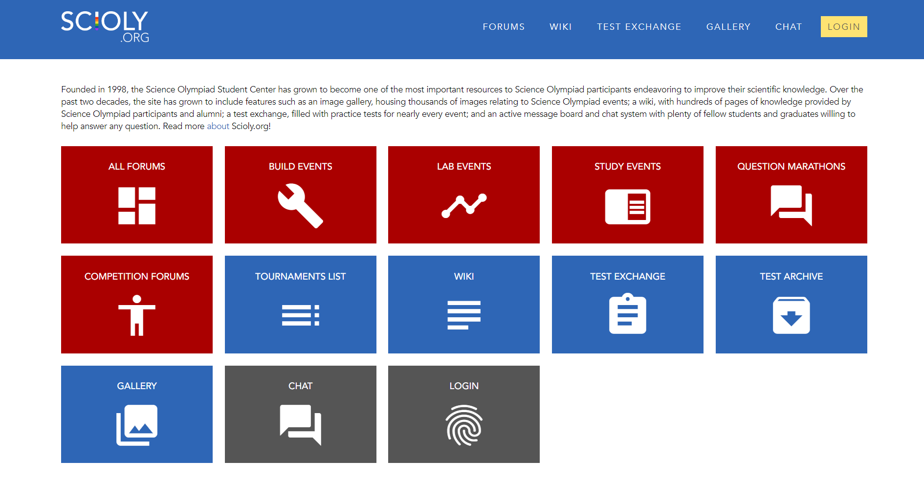
Resources to Check Out
Scioly.org
Soinc.org
SUBWAY STATIONS
Yes, Saturn is the ringed one. This planet is a gas giant, and it’s composed mostly of hydrogen and helium
Notes:
Here, you can link or mention any online or book resources that helped you in this event when you were a competitor. Try to avoid general resources like scioly wiki, because they probably already are familiar with it.

Slide 23
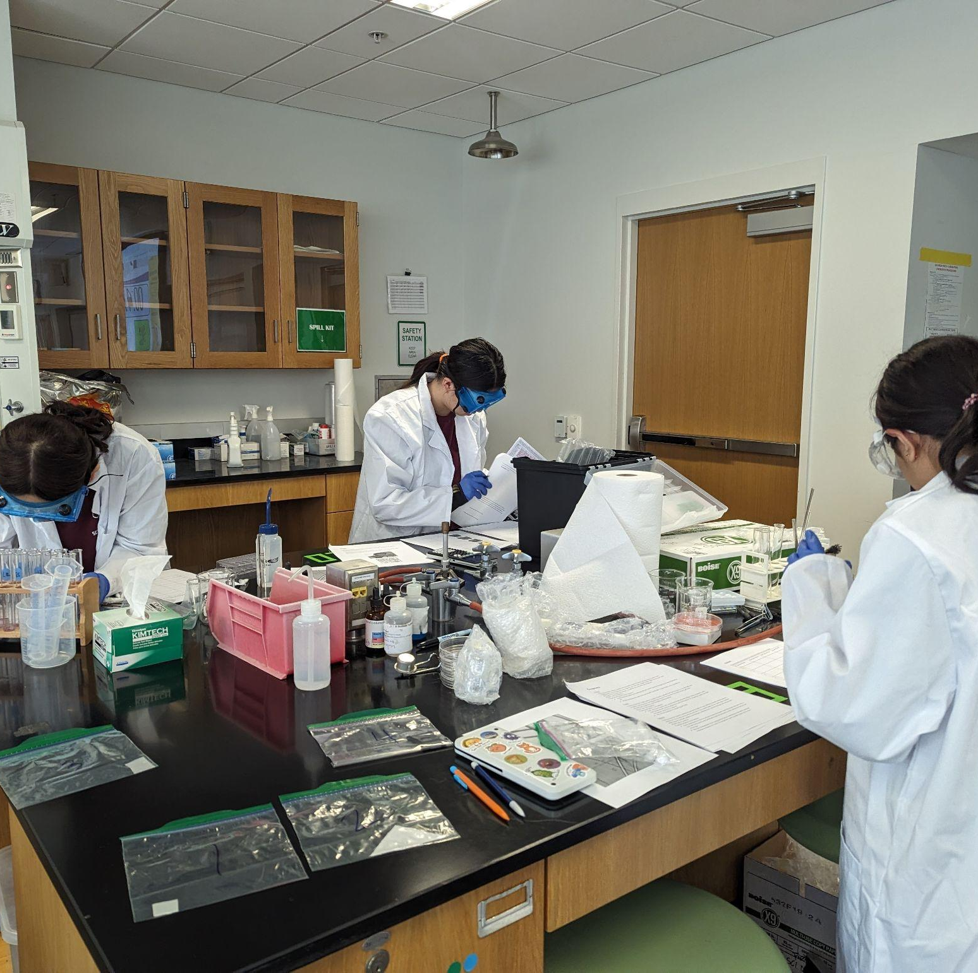
THANKS!
Notes:
(replace picture with a picture from one of our tournaments)

